Slide 1
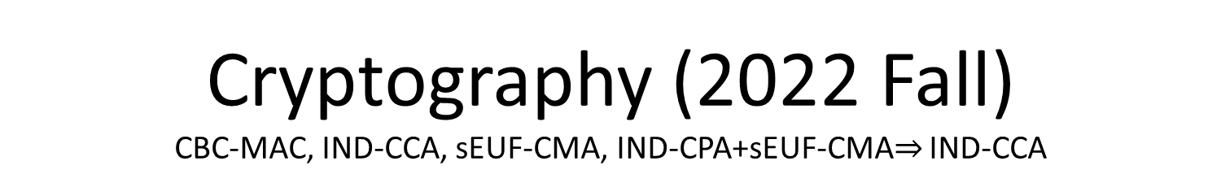
Cryptography (2022 Fall) CBC-MAC, IND-CCA, sEUF-CMA, IND-CPA+sEUF-CMA$⇒$ IND-CCA
LiangFeng Zhang
zhanglf@shanghaitech.edu.cn
SIST, ShanghaiTech

Slide 2
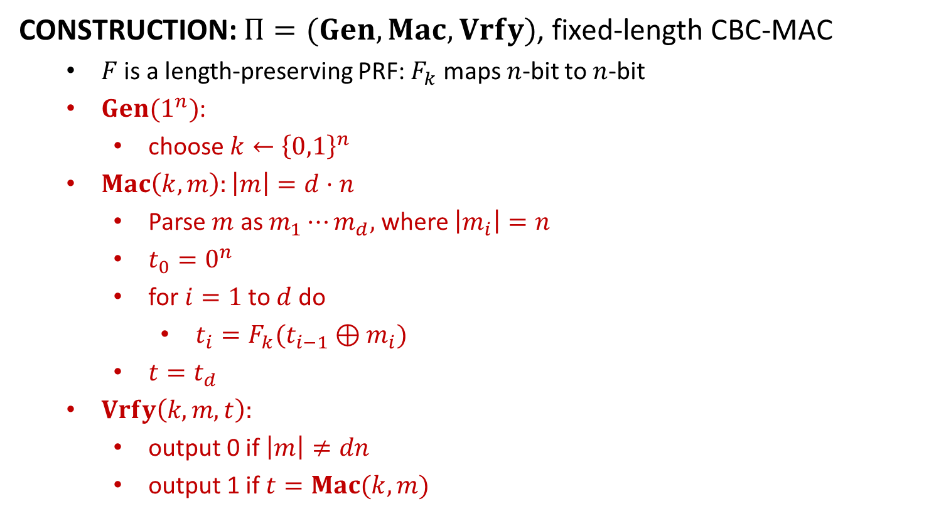
Fixed-Length CBC-MAC
CONSTRUCTION: $Π=(Gen, Mac,Vrfy)$, fixed-length CBC-MAC
$F$ is a length-preserving PRF: $F_{k}$ maps $n$-bit to $n$-bit
$Gen(1^{n})$:
choose $k←{\left\{0,1\right\}}^{n}$
$Mac\left(k,m\right):\left|m\right|=d⋅n$
Parse $m$ as $m_{1}⋯m_{d},$ where $\left|m_{i}\right|=n$
$t_{0}=0^{n}$
for$i=1$to$d$do
$t_{i}=F_{k}(t_{i−1}⊕m_{i})$
$t=t_{d}$
$Vrfy\left(k,m,t\right):$
output 0 if $\left|m\right|≠dn$
output 1 if $t=Mac(k,m)$
$$m_{1}$$
$$m_{2}$$
$$m_{3}$$
$$⨁$$
$$⨁$$
$$F_{k}$$
$$F_{k}$$
$$F_{k}$$
$$t$$

Slide 3
Fixed-Length CBC-MAC
THEOREM: If $F$ is a PRF, then the fixed-length CBC-MAC is an EUF-CMA
secure MAC scheme for messages of length $dn$.
$d$ can be any polynomial of $n$
However, $d$ must be fixed once it was chosen
Compare with CBC Mode of Encryption:
Advantages: compared with the PRF-based MAC constructions
(Fixed-Length) CBC-MAC vs. (Fixed-Length) MAC from PRF:
authenticate $dn$-bit messages vs. authenticate $n$-bit messages
(Fixed-Length) CBC-MAC vs. (Arbitrary-Length) MAC from PRF:
$n$-bit tags vs. $4dn+\frac{n}{4}$-bit tags
$d$ PRF computations vs. $4d$ PRF computations
 | Initial vector $IV$ | Output
CBC Mode of Encryption | $$IV←{\left\{0,1\right\}}^{n}$$ | $$(IV,t_{1},…,t_{d})$$
Fixed-Length CBC-MAC | $$IV=0^{n}$$ | $$t_{d}$$

Slide 4

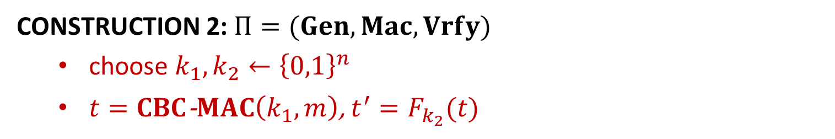
Arbitrary-Length CBC-MAC
CONSTRUCTION 1: $Π=(Gen, Mac,Vrfy)$, arbitrary-length CBC-MAC
prepend $\left|m\right|∈{\left\{0,1\right\}}^{n}$ to $m=m_{1}⋯m_{d}$
$t=CBC$-$MAC(k, \left|m\right| || m)$
$$|m|$$
$$m_{1}$$
$$m_{2}$$
$$m_{3}$$
$$m_{1}$$
$$m_{2}$$
$$m_{3}$$
$$⨁$$
$$⨁$$
$$⨁$$
$$⨁$$
$$⨁$$
$$F_{k}$$
$$F_{k}$$
$$F_{k}$$
$$F_{k}$$
$$F_{k_{1}}$$
$$F_{k_{1}}$$
$$F_{k_{1}}$$
$$F_{k_{2}}$$
$$t$$
$$t$$
Construction 1
Construction 2
$$t^{′}$$
CONSTRUCTION 2: $Π=(Gen, Mac,Vrfy)$
choose $k_{1}, k_{2}←{\left\{0,1\right\}}^{n}$
$t=CBC$-$MAC\left(k_{1},m\right)$, $t^{′}=F_{k_{2}}(t)$

Slide 6












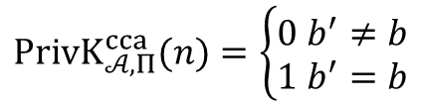
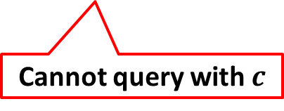
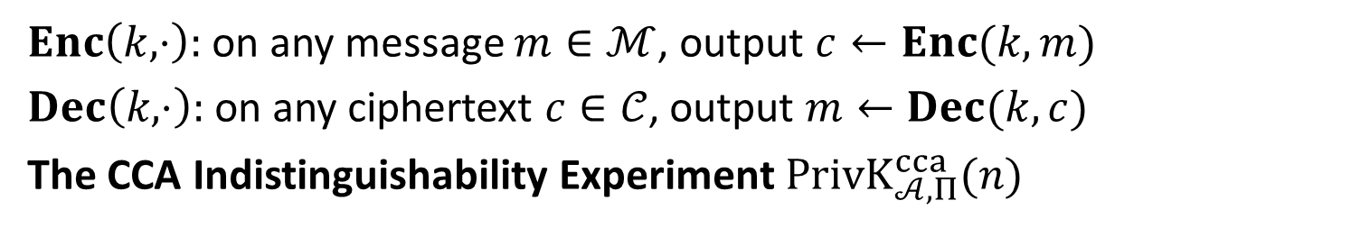


$$\text{Chosen}\text{−}\text{Ciphertext} \text{Attack}$$
$Enc\left(k,⋅\right):$on any message $m∈ℳ$, output $c←Enc(k,m)$
$Dec\left(k,⋅\right):$on any ciphertext $c∈𝒞$, output $m←Dec(k,c)$
The CCA Indistinguishability Experiment $PrivK_{𝒜, Π}^{cca}(n)$
$$k←Gen\left(1^{n}\right)$$
$$oracle access to$$
$$Enc\left(k,⋅\right), Dec(k,⋅)$$
$$m_{0},m_{1}$$
$$\left|m_{0}\right|=|m_{1}|$$
$$Challenger$$
$$b←\{0,1\}$$
$$Adversary 𝒜$$
$$c←Enc(k,m_{b})$$
$$c$$
$$oracle access to$$
$$Enc\left(k,⋅\right), Dec(k,⋅)$$
$$b′$$
$$PrivK_{𝒜, Π}^{cca}(n)=\left\{\begin{aligned}0 b^{′}≠b \\ 1 b^{′}=b\end{aligned}\right.$$
Cannot query with $c$

Slide 7
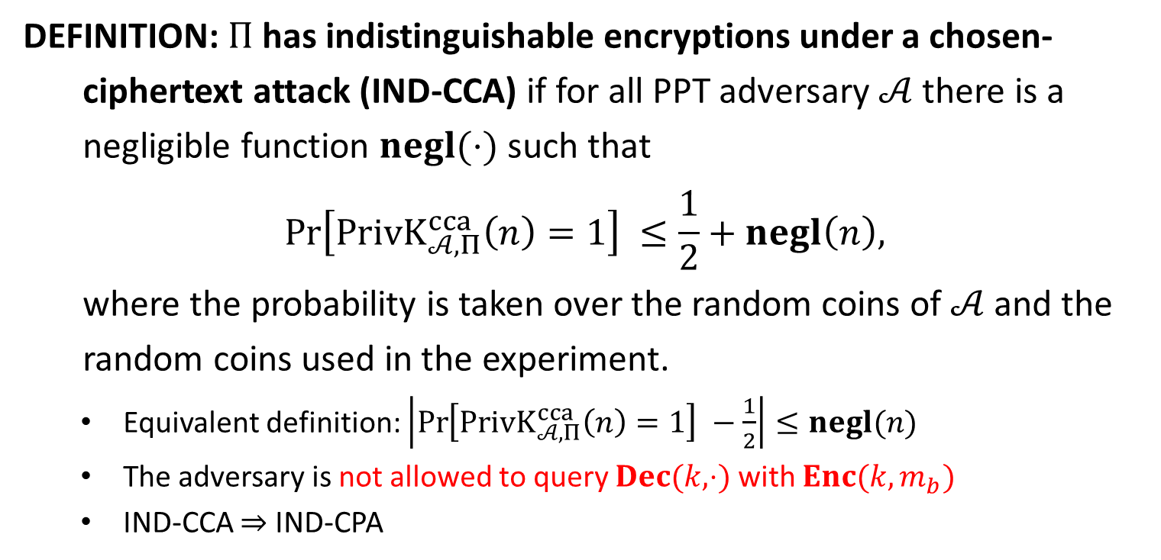
IND-CCA
DEFINITION: $Π$has indistinguishable encryptions under a chosen-
ciphertext attack (IND-CCA) if for all PPT adversary $𝒜$ there is a
negligible function $negl(⋅)$ such that
$$\operatorname{Pr}\left[PrivK_{𝒜, Π}^{cca}\left(n\right)=1\right] ≤\frac{1}{2}+negl\left(n\right),$$
where the probability is taken over the random coins of $𝒜$ and the
random coins used in the experiment.
Equivalent definition: $\left|\operatorname{Pr}\left[PrivK_{𝒜, Π}^{cca}\left(n\right)=1\right] −\frac{1}{2}\right|≤negl(n)$
The adversary is not allowed to query $Dec(k,⋅)$ with $Enc(k,m_{b})$
IND-CCA $⇒$ IND-CPA

Slide 8

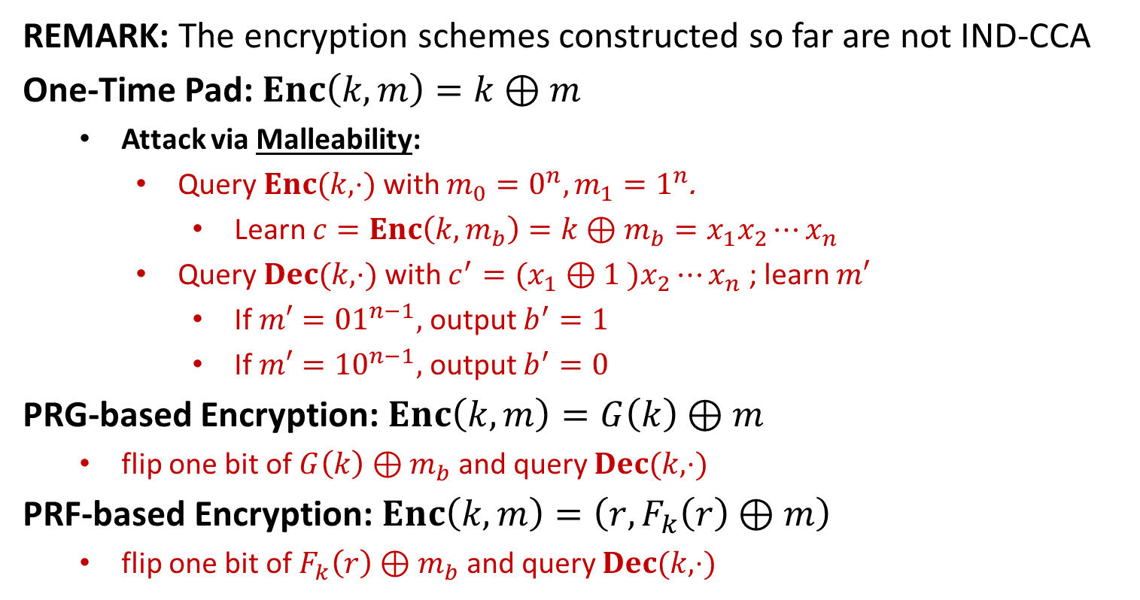







Examples of CCA
REMARK: The encryption schemes constructed so far are not IND-CCA
One-Time Pad: $Enc\left(k,m\right)=k⊕m$
Attack via Malleability:
Query $Enc(k,⋅)$ with $m_{0}=0^{n},m_{1}=1^{n}$.
Learn $c=Enc\left(k,m_{b}\right)=k⊕m_{b}=x_{1}x_{2}⋯x_{n}$
Query $Dec(k,⋅)$ with $c^{′}=(x_{1}⊕1 )x_{2}⋯x_{n}$ ; learn $m′$
If $m′={01}^{n−1},$ output $b^{′}=1$
If $m′={10}^{n−1},$ output $b^{′}=0$
PRG-based Encryption: $Enc\left(k,m\right)=G\left(k\right)⊕m$
flip one bit of $G\left(k\right)⊕m_{b}$ and query $Dec(k,⋅)$
PRF-based Encryption: $Enc\left(k,m\right)=\left(r,F_{k}\left(r\right)⊕m\right)$
flip one bit of $F_{k}\left(r\right)⊕m_{b}$ and query $Dec(k,⋅)$
$$m$$
$$Enc$$
$$c$$
$$f′$$
$$f$$
$$m′$$
$$c′$$
$$Dec$$

Slide 9








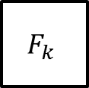





Examples of CCA
OFB: $F$ is a block cipher with block length $n$
$$IV$$
$$F_{k}$$
$$F_{k}$$
$$F_{k}$$
$$m_{1}$$
$$⨁$$
$$m_{2}$$
$$⨁$$
$$m_{3}$$
$$⨁$$
$$IV$$
$$c_{1}$$
$$c_{2}$$
$$c_{3}$$
Attack via Malleability:
Flip one bit of $c_{1}$ and query the decryption oracle

Slide 10









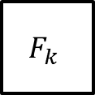



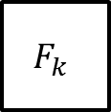


Examples of CCA
CTR: $F$ is a block cipher with block length $n$
$$ctr$$
$$ctr+1$$
$$ctr+2$$
$$ctr+3$$
$$F_{k}$$
$$F_{k}$$
$$F_{k}$$
$$m_{1}$$
$$⨁$$
$$m_{2}$$
$$⨁$$
$$m_{3}$$
$$⨁$$
$$ctr$$
$$c_{1}$$
$$c_{2}$$
$$c_{3}$$
Attack via Malleability:
Flip one bit of $c_{1}$ and query the decryption oracle

Slide 11


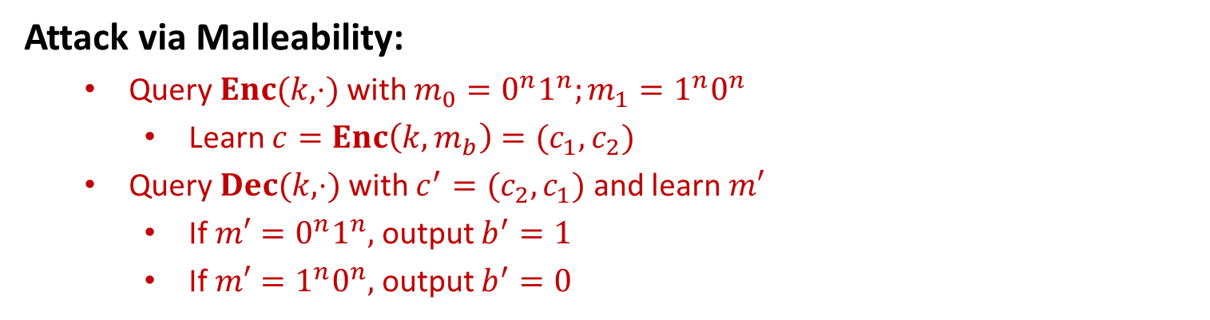






Examples of CCA
ECB: $F$ is a block cipher with block length $n$
$$m_{1}$$
$$m_{2}$$
$$m_{3}$$
$$F_{k}$$
$$F_{k}$$
$$F_{k}$$
$$c_{1}$$
$$c_{2}$$
$$c_{3}$$
Attack via Malleability:
Query $Enc(k,⋅)$ with $m_{0}=0^{n}1^{n};m_{1}=1^{n}0^{n}$
Learn $c=Enc\left(k,m_{b}\right)=(c_{1},c_{2})$
Query $Dec(k,⋅)$ with $c^{′}=(c_{2},c_{1})$ and learn $m′$
If $m′={0^{n}1}^{n},$ output $b^{′}=1$
If $m′={1^{n}0}^{n},$ output $b^{′}=0$

Slide 12




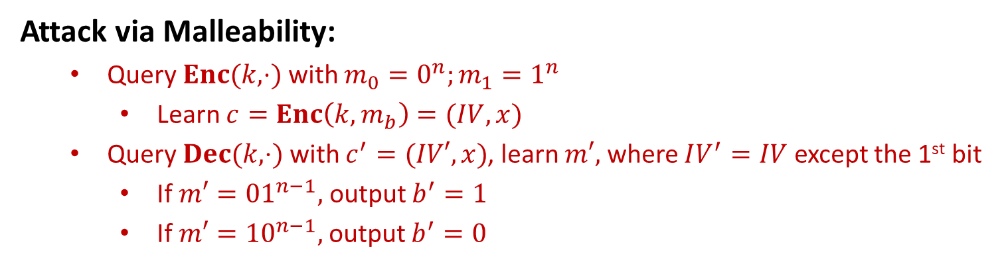



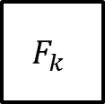





Examples of CCA
CBC: $F$ is a block cipher with block length $n$
$$m_{1}$$
$$m_{2}$$
$$m_{3}$$
$$IV$$
$$⨁$$
$$⨁$$
$$⨁$$
$$F_{k}$$
$$F_{k}$$
$$F_{k}$$
$$IV$$
$$c_{1}$$
$$c_{2}$$
$$c_{3}$$
Attack via Malleability:
Query $Enc(k,⋅)$ with $m_{0}=0^{n};m_{1}=1^{n}$
Learn $c=Enc\left(k,m_{b}\right)=(IV,x)$
Query $Dec(k,⋅)$ with $c^{′}=(IV′,x)$, learn $m′,$ where $IV^{′}=IV$ except the 1st bit
If $m′={01}^{n−1},$ output $b^{′}=1$
If $m′={10}^{n−1},$ output $b^{′}=0$

Slide 14


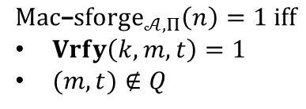





sEUF-CMA
The Strong Message Authentication Experiment: $Mac$-$sforge_{𝒜,Π}(n)$
$$k←Gen\left(1^{n}\right)$$
$$orace access to$$
$$Mac(k,⋅)$$
$$Challenger$$
$$Adversary 𝒜$$
$$(m,t)$$
$$Mac\text{−}sforge_{𝒜,Π}\left(n\right)=1 iff$$
$Vrfy\left(k,m,t\right)=1$
$(m,t)∉Q$
$Q:$ the set of (message, tag) pairs queried by $𝒜$

Slide 15
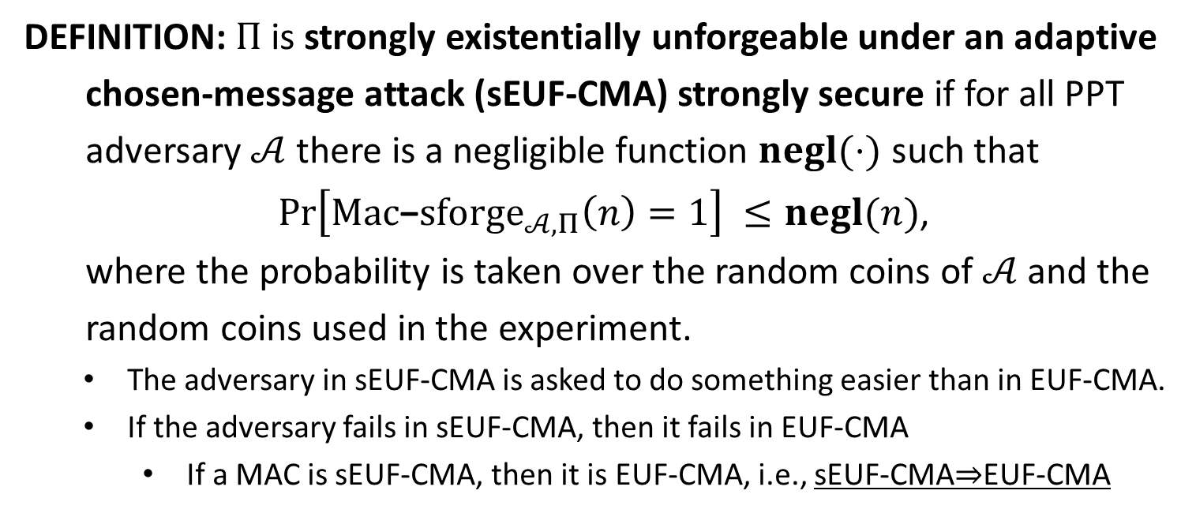
sEUF-CMA
DEFINITION: $Π$is strongly existentially unforgeable under an adaptive
chosen-message attack (sEUF-CMA) strongly secure if for all PPT
adversary $𝒜$ there is a negligible function $negl(⋅)$ such that
$\operatorname{Pr}\left[Mac\text{−}sforge_{𝒜,Π}\left(n\right)=1\right] ≤negl(n)$,
where the probability is taken over the random coins of $𝒜$ and the
random coins used in the experiment.
The adversary in sEUF-CMA is asked to do something easier than in EUF-CMA.
If the adversary fails in sEUF-CMA, then it fails in EUF-CMA
If a MAC is sEUF-CMA, then it is EUF-CMA, i.e., sEUF-CMA$⇒$EUF-CMA

Slide 16

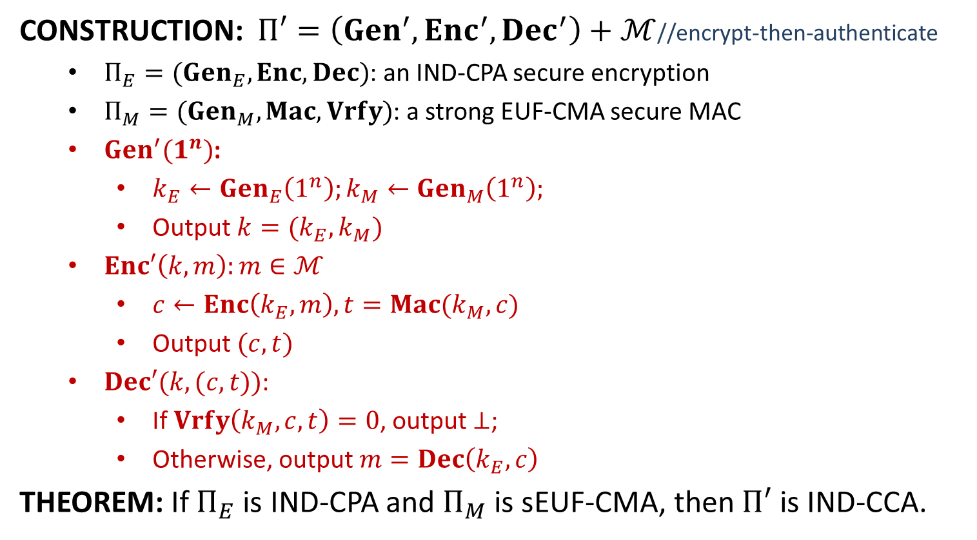
IND-CPA+sEUF-CMA$⇒$ IND-CCA
CONSTRUCTION: $Π′=\left(Gen^{′}, Enc^{′}, Dec^{′}\right)+ℳ$//encrypt-then-authenticate
$Π_{E}=(Gen_{E}, Enc, Dec)$: an IND-CPA secure encryption
$Π_{M}=(Gen_{M}, Mac, Vrfy)$: a strong EUF-CMA secure MAC
$Gen^{′}(1^{n})$:
$k_{E}←Gen_{E}\left(1^{n}\right);k_{M}←Gen_{M}\left(1^{n}\right);$
Output $k=(k_{E},k_{M})$
$Enc′\left(k,m\right):m∈ℳ$
$c←Enc\left(k_{E},m\right), t=Mac(k_{M},c)$
Output $(c,t)$
$Dec′(k,(c,t))$:
If $Vrfy\left(k_{M}, c,t\right)=0$, output $⊥$;
Otherwise, output $m=Dec\left(k_{E},c\right)$
THEOREM: If $Π_{E}$ is IND-CPA and $Π_{M}$ is sEUF-CMA, then $Π′$ is IND-CCA.

Slide 17
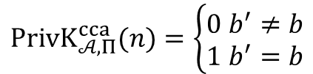




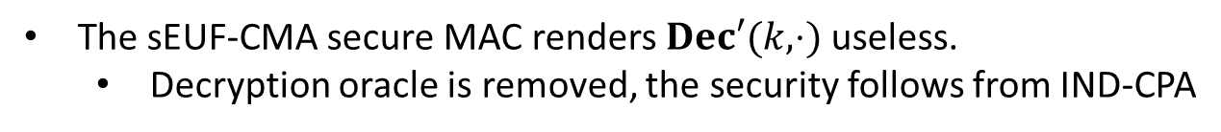









Security
$$k←Gen′\left(1^{n}\right)$$
$$oracle access to$$
$$Enc′\left(k,⋅\right), Dec′(k,⋅)$$
$$m_{0},m_{1}$$
$$\left|m_{0}\right|=|m_{1}|$$
$$Challenger$$
$$b←\{0,1\}$$
$$Adversary 𝒜$$
$$c←Enc′(k,m_{b})$$
$$c$$
$$oracle access to$$
$$Enc′\left(k,⋅\right), Dec′(k,⋅)$$
$$b′$$
$$PrivK_{𝒜, Π}^{cca}(n)=\left\{\begin{aligned}0 b^{′}≠b \\ 1 b^{′}=b\end{aligned}\right.$$
The sEUF-CMA secure MAC renders $Dec′(k,⋅)$ useless.
Decryption oracle is removed, the security follows from IND-CPA

